Slide 1

Topic: APPLICATION OF RESIDUE THEOREM TO EVALUATE REAL INTEGRATION​
SE Sem IV- 2024-25
Guide
Prof. Madhavi Mali
Department Of Computer Engineering
Watumull Institute Of Engineering And Computer Technology

Slide 2

Group Members:
Soniya Pawar (Roll No:88)
Yash Pawar (Roll No:89)
Praneet Poojary (Roll No:90)
Sukriti Prajapati (Roll No:91)
Premsing Rathod (Roll No:92)
Akshay Raut (Roll No:93)
GitHub Link:
https://github.com/nothingmatters4/Maths4_MiniProject.git

Slide 3
Introduction
In complex analysis, evaluating certain real integrals directly can be challenging or even impossible using standard calculus techniques. However, complex analysis offers a powerful method through contour integration and the Residue Theorem.
The Residue Theorem from complex analysis provides an efficient method to evaluate certain difficult real integrals by converting them into contour integrals in the complex plane.

Slide 4
Challenges & Limitations
Contour Selection: Choosing the right contour is not always easy, especially when dealing with multiple or complex poles.
Difficult Residue Calculation: Finding residues, especially at higher-order poles, can involve lengthy and complex algebra.
Improper Decay at Infinity:If the integrand doesn't vanish at infinity, the integral over the arc may not approach zero, invalidating the method.
Non-Rational Functions: The method is most effective for rational functions; applying it to irrational or transcendental functions can be difficult or impossible.

Slide 5
.
.
.
Importance of the Topic: Applications in Different Fields
Advanced Systems & Signal Engineering: The Residue Theorem is vital for evaluating complex integrals in Laplace and Fourier transforms, used in system modeling and analysis.
Electrical and Electronic Communications: Residue methods help evaluate the performance of communication systems by solving integrals related to signal behavior.
Quantitative Finance & Economic Forecasting: Supports the development of derivative pricing, portfolio risk assessments, and stochastic financial models.
Social Analytics & Behavioral Modeling:Helps evaluate integrals in signal processing algorithms used in radar, sonar, and defense systems.
Plasma Physics:The Residue Theorem is used to evaluate complex integrals that appear in the study of plasma waves and instabilities.
Intelligent Systems: Contributes to mathematical frameworks used in machine learning and probabilistic modeling.

Slide 6
Concept of the Topic and Explanation (Steps to Solve)
The Residue Theorem from complex analysis helps evaluate real definite integrals,especially those that are difficult to solve using standard calculus.
It works by converting a real integral into a complex contour integral, then
calculating residues at the poles inside the contour.
Commonly used for:
Improper integrals over (−∞,∞)
Rational and trigonometric integrals
Laplace and Fourier transforms

Slide 7
Steps:
Convert the real integral into a complex function f(z)f(z)f(z)
Choose a contour (semicircular or circular) in the complex plane
Identify poles of f(z)f(z)f(z) inside the contour
Calculate residues at those poles
Apply the Residue Theorem: ∮f(z)dz=2πi∑Res(f,zk​)
Relate the result back to the original real integral
Simplify and conclude the value

Slide 8
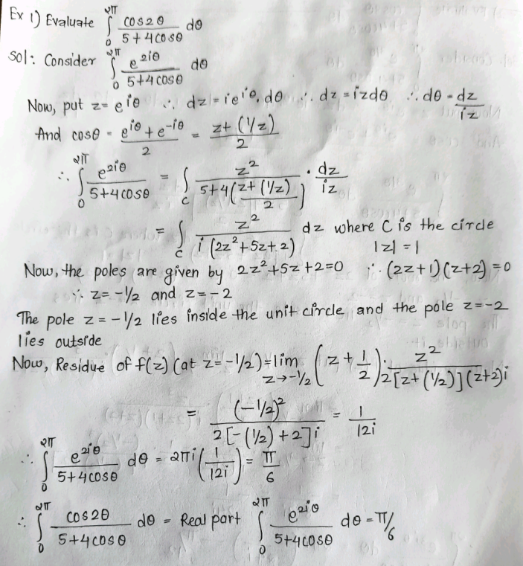
Example 1)

Slide 9
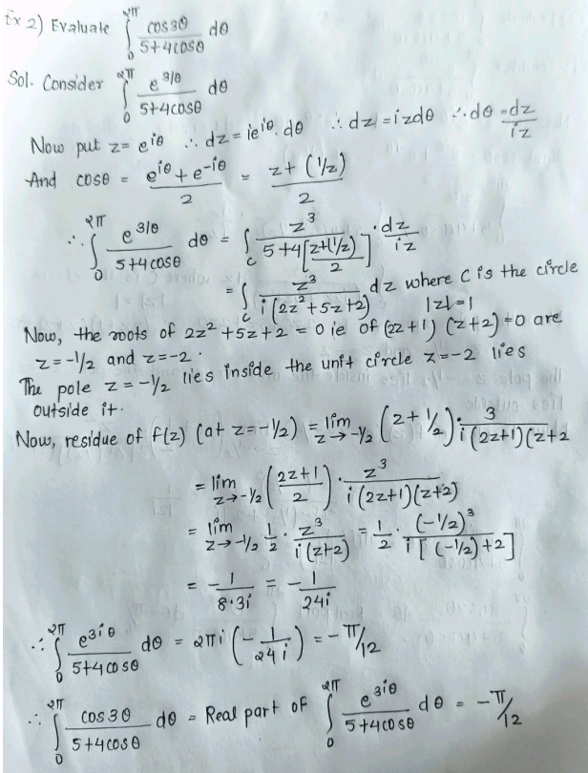
Example 2)

Slide 10
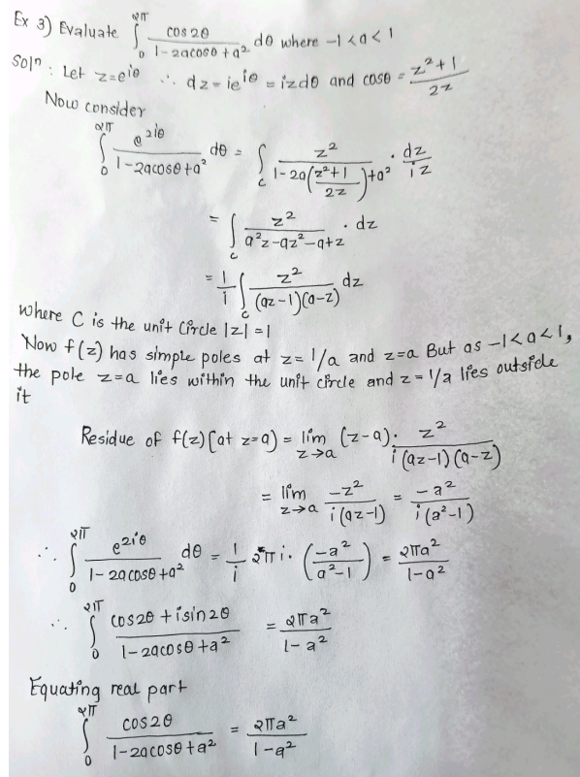
Example 3)

Slide 11
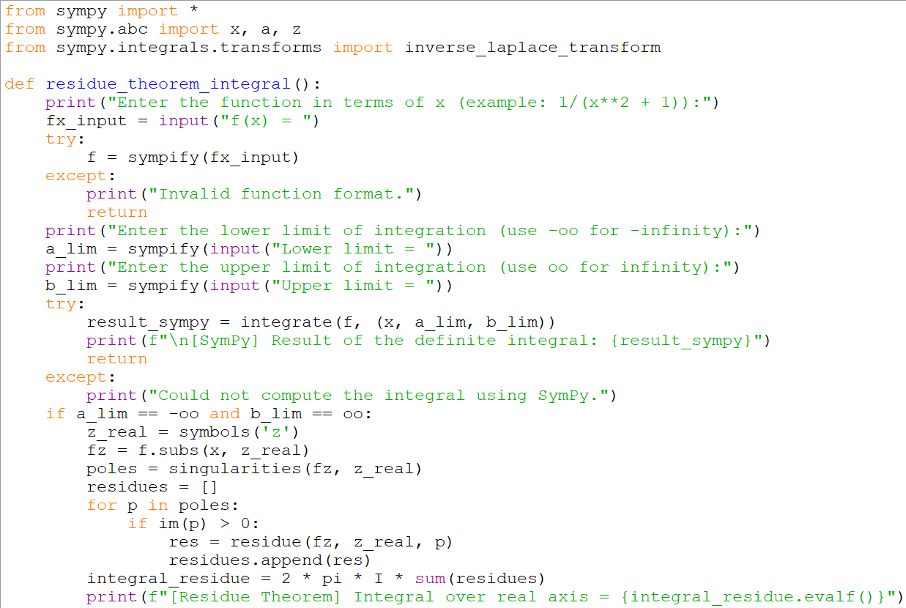
CODE
DEMONSTRATION:

Slide 12
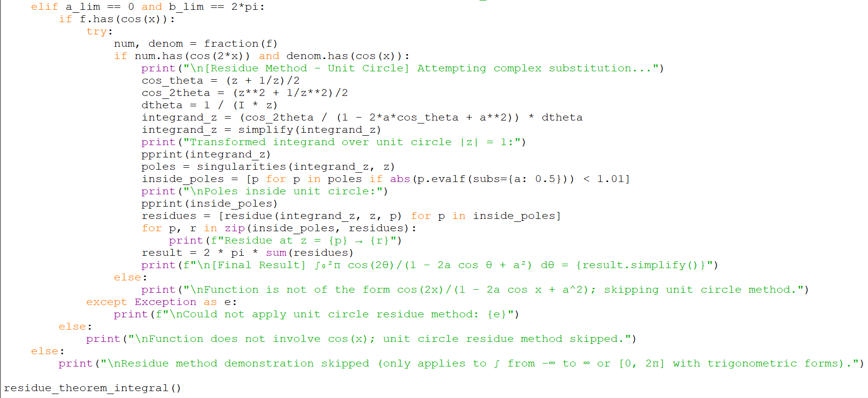

Slide 13
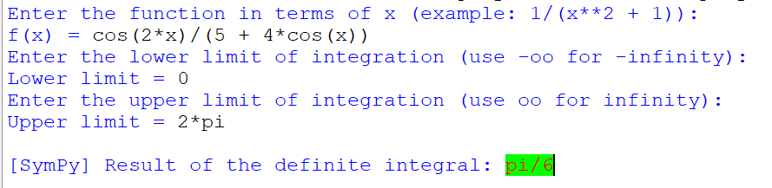
EXAMPLE 1:

Slide 14
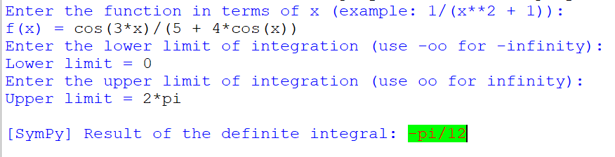
EXAMPLE 2:

Slide 15
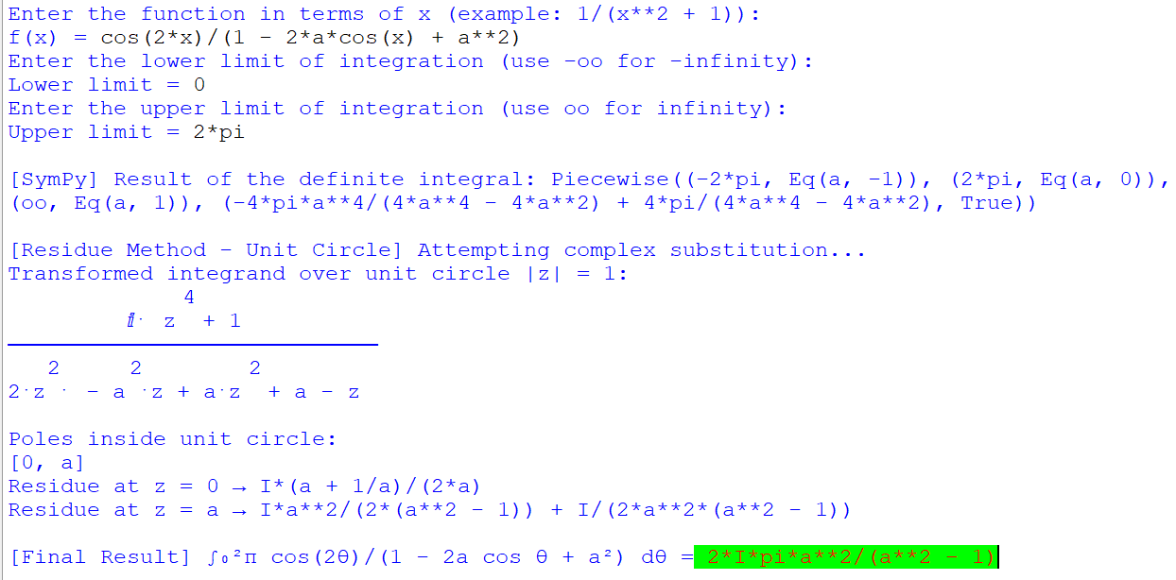
EXAMPLE 3:

Slide 16
References
Churchill, R. V., & Brown, J. W. (2009). Complex Variables and Applications. McGraw-Hill.
Kreyszig, E. (2011). Advanced Engineering Mathematics. Wiley.
Spiegel, M. R., et al. (2009). Schaum's Outline of Complex Variables. McGraw-Hill.
Marsden, J. E., & Hoffman, M. J. (1999). Basic Complex Analysis. W. H. Freeman.
Paul’s Online Math Notes – Complex Integration and Residue Theorem 🌐 tutorial.math.lamar.edu

Slide 17
Conclusion
The Residue Theorem is a powerful tool in complex analysis that simplifies the evaluation of difficult real integrals.
By converting real integrals into complex contour integrals, it allows for easier computation using residues at singularities.
This method is widely used in engineering, physics, signal processing, and other applied fields.
Understanding and applying the theorem strengthens problem-solving skills in both pure and applied mathematics.
Overall, it bridges the gap between real and complex analysis and enhances our ability to solve integrals with elegance and efficiency.

